Slide 1
HYPOTHESIS TESTING

Slide 2
In this session ….
Hypothesis Testing
Setting Up a Test for a Population Proportion
Setting Up a Test of Difference in Population Proportions
Interview: P-Values, P-Hacking

Slide 3
What is Hypothesis Testing?
Hypothesis testing refers to
1. Making an assumption, called hypothesis, about a population
parameter.
Collecting sample data.
Calculating a sample statistic.
4. Using the sample statistic to evaluate the hypothesis (how likely is it that our hypothesized parameter is correct. To test the validity of our assumption we determine the difference between the hypothesized parameter value and the sample value.)

Slide 4
Hypothesis Testing
Null hypothesis 𝐻₀
The status quo that is assumed to be true
Alternative hypothesis (𝐻_{𝑎})
An alternative claim under consideration that will require statistical evidence to accept, and thus, reject the null hypothesis
We will consider 𝐻₀ to be true and accept it unless the evidence in favour of 𝐻_{𝑎} is so strong that we reject 𝐻₀ in favour of 𝐻_{𝑎}.

Slide 5

Introduction
The primary objective of statistical analysis is to use data from a sample to make inferences about the population from which the sample was drawn.
This lecture aims to learn the basic procedures for making such inferences.
$$\overline{X}$$

Slide 6
Basic Approaches
Approach 1: Hypothesis testing
We conduct test on hypothesis.
We hypothesize that one (or more) parameter(s) has (have) some specific value(s) or relationship.
Make our decision about the parameter(s) based on one (or more) sample statistic(s)
Accuracy of the decision is expressed as the probability that the decision is incorrect.
Approach 2: Confidence interval measurement
We estimate one (or more) parameter(s) using sample statistics.
This estimation usually done in the form of an interval.
Accuracy of the decision is expressed as the level of confidence we have in the interval.

Slide 7

Hypothesis Testing
What is Hypothesis?
“A hypothesis is an educated prediction that can be tested” (study.com).
“A hypothesis is a proposed explanation for a phenomenon” (Wikipedia).
“A hypothesis is used to define the relationship between two variables” (Oxford dictionary).
“A supposition or proposed explanation made on the basis of limited evidence as a starting point for further investigation” (Walpole).
Example 6.1: Avogadro’s Hypothesis(1811)
“The volume of a gas is directly proportional to the number of molecules of the gas.”
$$V=aN$$

Slide 8
Statistical Hypothesis
If the hypothesis is stated in terms of population parameters (such as mean and variance), the hypothesis is called statistical hypothesis.
Data from a sample (which may be an experiment) are used to test the validity of the hypothesis.
A procedure that enables us to agree (or disagree) with the statistical hypothesis is called a test of the hypothesis.
Example 6.2:
To determine whether the wages of men and women are equal.
A product in the market is of standard quality.
Whether a particular medicine is effective to cure a disease.

Slide 9
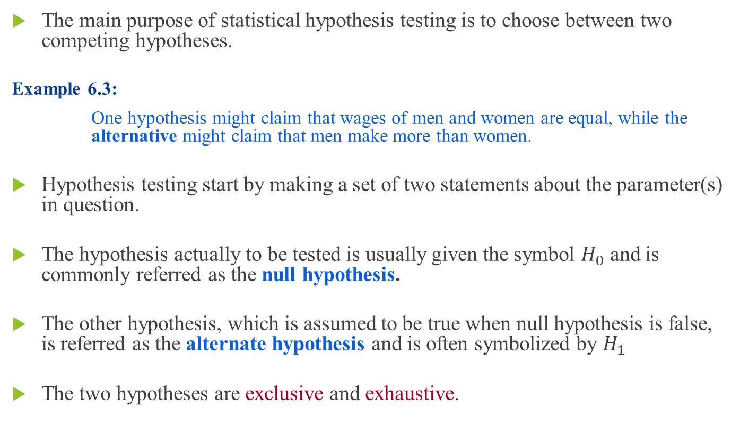
The Hypotheses
The main purpose of statistical hypothesis testing is to choose between two competing hypotheses.
Example 6.3:
One hypothesis might claim that wages of men and women are equal, while the alternative might claim that men make more than women.
Hypothesis testing start by making a set of two statements about the parameter(s) in question.
The hypothesis actually to be tested is usually given the symbol $H_{0}$ and is commonly referred as thenull hypothesis.
The other hypothesis, which is assumed to be true when null hypothesis is false, is referred as the alternate hypothesis and is often symbolized by $H_{1}$
The two hypotheses are exclusive and exhaustive.

Slide 10
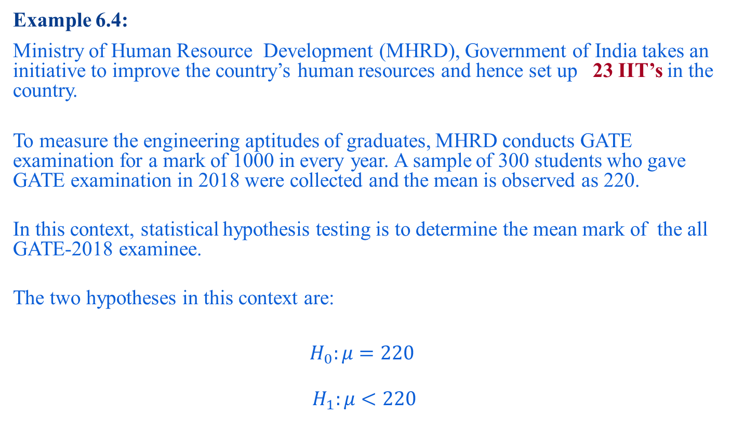
The Hypotheses
Example 6.4:
Ministry of Human Resource Development (MHRD), Government of India takes an initiative to improve the country’s human resources and hence set up 23 IIT’s in the country.
To measure the engineering aptitudes of graduates, MHRD conducts GATE examination for a mark of 1000 in every year. A sample of 300 students who gave GATE examination in 2018 were collected and the mean is observed as 220.
In this context, statistical hypothesis testing is to determine the mean mark of the all GATE-2018 examinee.
The two hypotheses in this context are:
$$H_{0}:μ=220$$
$$H_{1}:μ<220$$

Slide 11
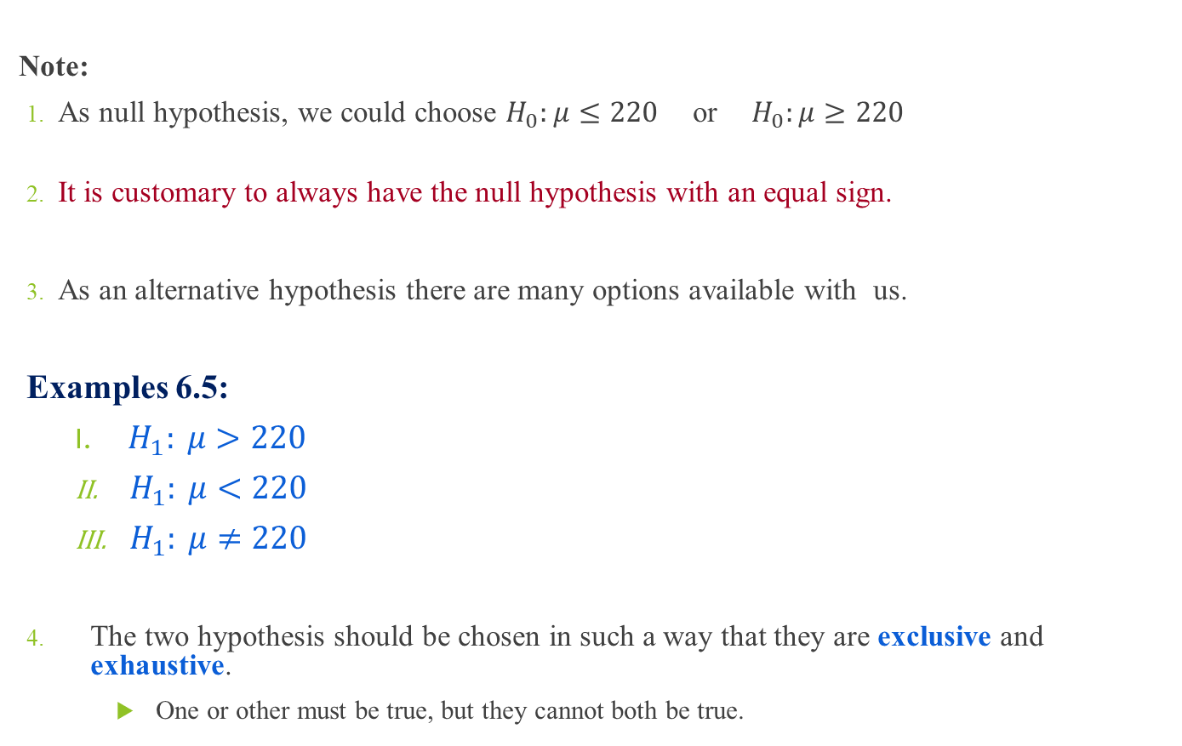
The Hypotheses
Note:
As null hypothesis, we could choose $H_{0}:μ≤220$or${ H}_{0}:μ≥220$
It is customary to always have the null hypothesis with an equal sign.
As an alternative hypothesis there are many options available with us.
Examples 6.5:
$H_{1}: μ>220$
${ H}_{1}: μ<220$
${ H}_{1}: μ≠220$
The two hypothesis should be chosen in such a way that they are exclusive and exhaustive.
One or other must be true, but they cannot both be true.

Slide 12
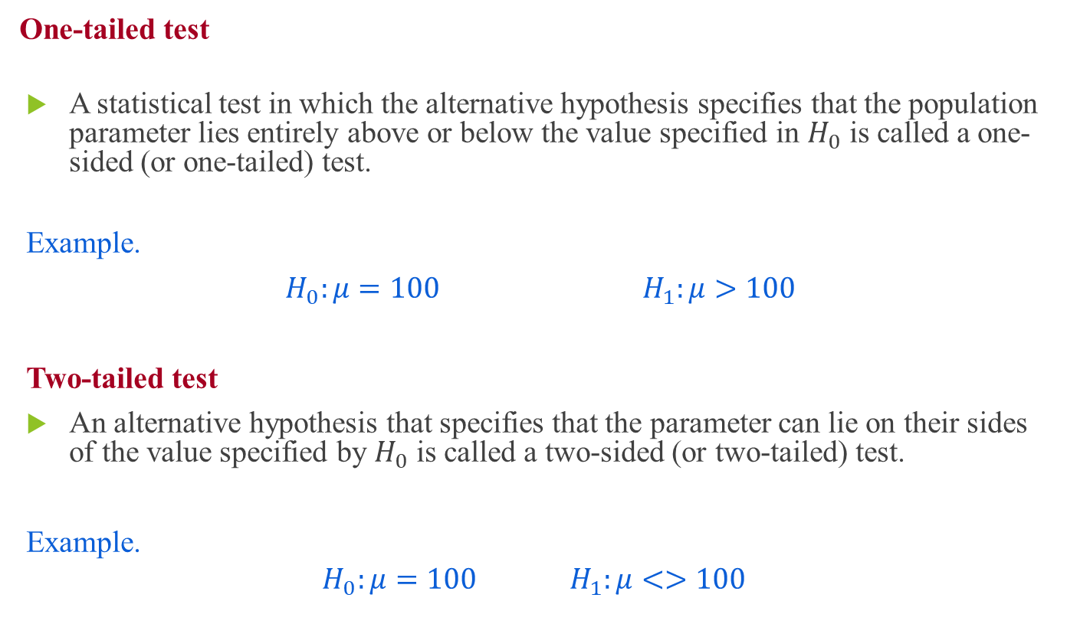
The Hypotheses
One-tailed test
A statistical test in which the alternative hypothesis specifies that the population parameter lies entirely above or below the value specified in $H_{0}$ is called a one-sided (or one-tailed) test.
Example.
$$H_{0}:μ=100 H_{1}:μ>100$$
Two-tailed test
An alternative hypothesis that specifies that the parameter can lie on their sides of the value specified by $H_{0}$ is called a two-sided (or two-tailed) test.
Example.
$$H_{0}:μ=100 H_{1}:μ<>100$$

Slide 13



The Hypotheses
Note:
In fact, a 1-tailed test such as:
is same as
In essence, $μ>100,$ it does not imply that $μ>80,μ>90$, etc.
$$H_{0}:μ=100$$
$$H_{1}:μ>100$$
$$H_{0}:μ≤100$$
$$H_{1}:μ>100$$

Slide 14
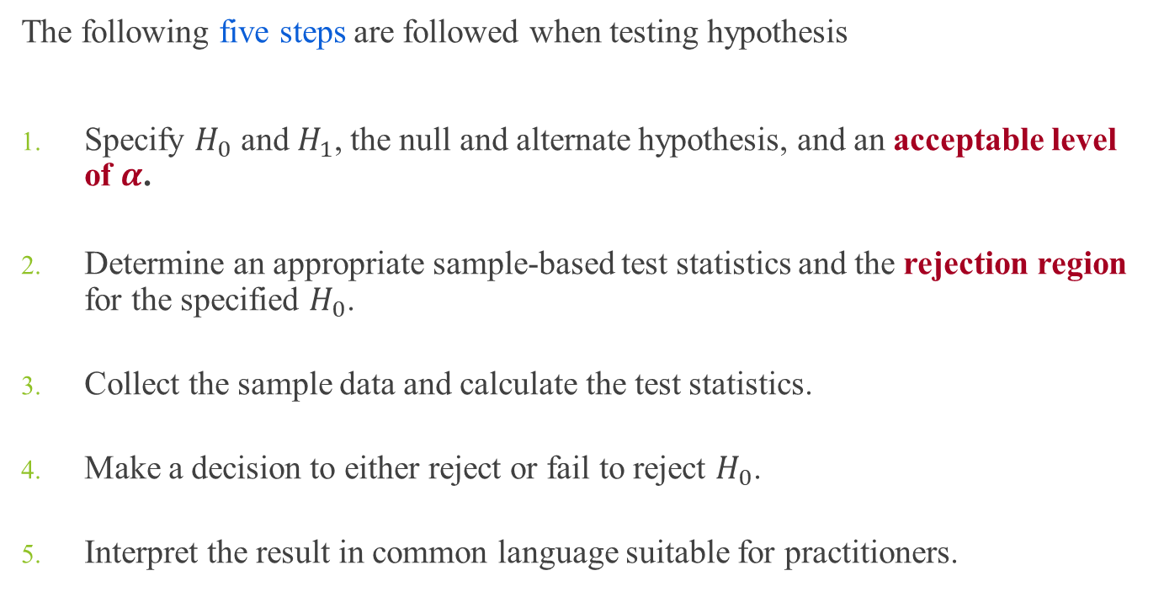
Hypothesis Testing Procedures
The following five steps are followed when testing hypothesis
Specify $H_{0}$ and $H_{1}$, the null and alternate hypothesis, and an acceptable level of $α$.
Determine an appropriate sample-based test statistics and the rejection region for the specified $H_{0}$.
Collect the sample data and calculate the test statistics.
Make a decision to either reject or fail to reject $H_{0}$.
Interpret the result in common language suitable for practitioners.

Slide 15
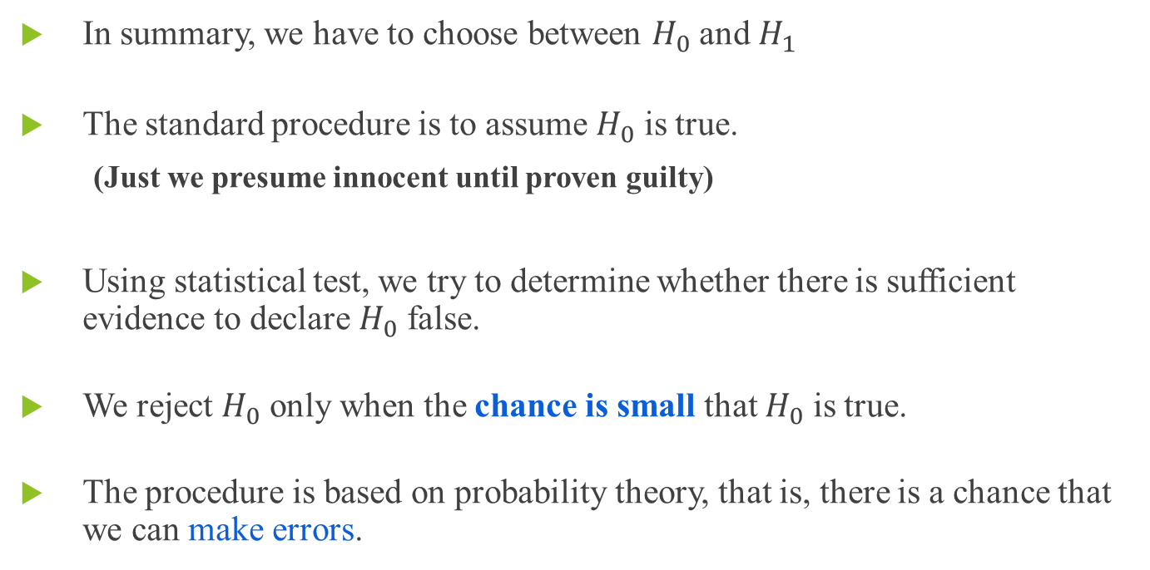
Hypothesis Testing Procedure
In summary, we have to choose between $H_{0}$ and $H_{1}$
The standard procedure is to assume $H_{0}$ is true.
(Just we presume innocent until proven guilty)
Using statistical test, we try to determine whether there is sufficient evidence to declare $H_{0}$ false.
We reject $H_{0}$ only when the chance is smallthat $H_{0}$ is true.
The procedure is based on probability theory, that is, there is a chance that we can make errors.

Slide 16
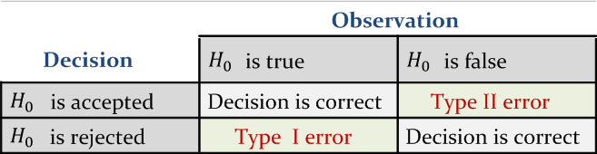
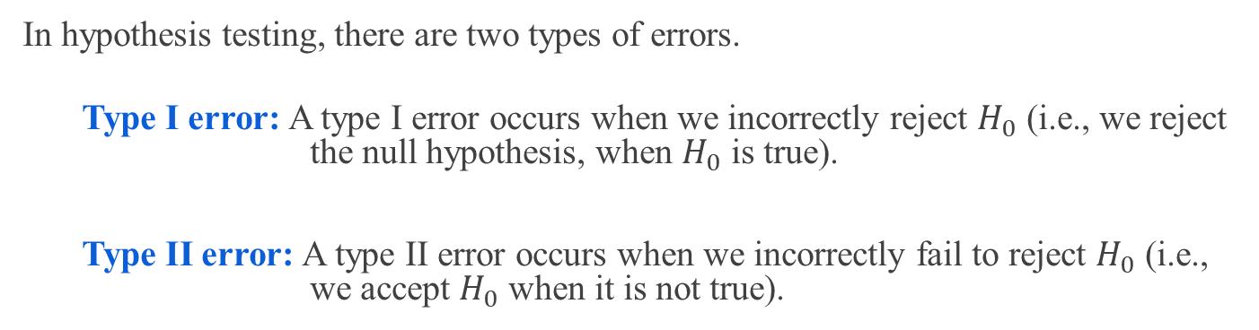
Errors in Hypothesis Testing
In hypothesis testing, there are two types of errors.
Type I error: A type I error occurs when we incorrectly reject $H_{0}$ (i.e., we reject the null hypothesis, when $H_{0}$ is true).
Type II error: A type II error occurs when we incorrectly fail to reject $H_{0}$ (i.e., we accept $H_{0}$ when it is not true).

Slide 17
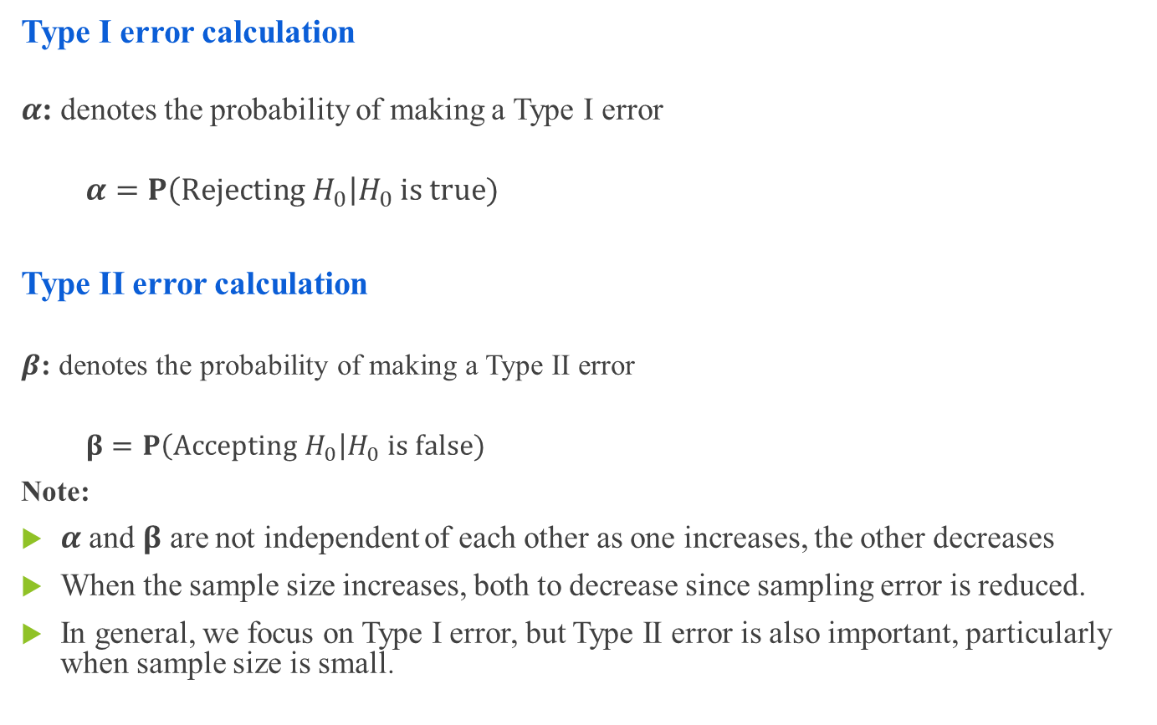
Probabilities of Making Errors
Type I error calculation
$α$: denotes the probability of making a Type I error
$$α=P\left(Rejecting H_{0}\right|H_{0} is true)$$
Type II error calculation
$β$: denotes the probability of making a Type II error
$$β=P\left(Accepting H_{0}\right|H_{0} is false)$$
Note:
$α$ and $β$ are not independent of each other as one increases, the other decreases
When the sample size increases, both to decrease since sampling error is reduced.
In general, we focus on Type I error, but Type II error is also important, particularly when sample size is small.

Slide 18

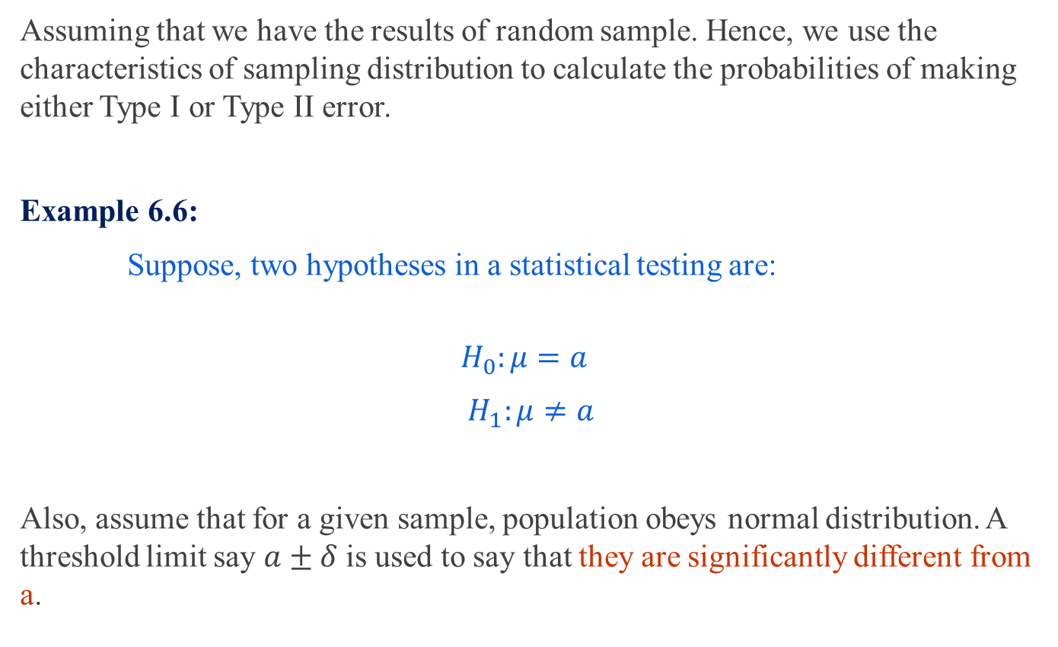
Calculating$α$
Assuming that we have the results of random sample. Hence, we use the characteristics of sampling distribution to calculate the probabilities of making either Type I or Type II error.
Example 6.6:
Suppose, two hypotheses in a statistical testing are:
$$H_{0}:μ=a$$
$$H_{1}:μ≠a$$
Also, assume that for a given sample, population obeys normal distribution. A threshold limit say $a±δ$ is used to say that they are significantly different from a.

Slide 19


Calculating$α$
Thus the null hypothesis is to be rejected if the mean value is less than $a−δ$ or greater than $a+δ$.
If $\overline{X}$ denotes the sample mean, then the Type I error is
$$α=P(\overline{X}<a−δ or \overline{X}>a+δ, when μ=a , i.e.,{ H}_{0} is true)$$
Here, shaded region implies the probability that, $\overline{X}<a−δ or\overline{X}>a+δ$

Slide 20

The Rejection Region
The rejection region comprises of value of the test statistics for which
The probability when the null hypothesis is true is less than or equal to the specified $α$.
Probability when $H_{1 }$is true are greater than they are under $H_{0}$.

Slide 21

Two-Tailed Test
For two-tailed hypothesis test, hypotheses take the form
$$H_{0}:μ=μ_{H_{0}}$$
$$H_{1}:μ≠μ_{H_{0}}$$
In other words, to reject a null hypothesis, sample mean $μ>μ_{H_{0}}$ or $μ<μ_{H_{0}}$ under a given $α$.
Thus, in a two-tailed test, there are two rejection regions (also known as critical region), one on each tail of the sampling distribution curve.

Slide 22
Two-Tailed Test
Acceptance and rejection regions in case of a two-tailed test with 5% significance level.

Slide 23



One-Tailed Test
A one-tailed test would be used when we are to test, say, whether the population mean is either lower or higher than the hypothesis test value.
Symbolically,
$$H_{0}:μ=μ_{H_{0}}$$
$${ H}_{1}:μ<μ_{H_{0}} [or μ>μ_{H_{0}}]$$
Wherein there is one rejection region only on the left-tail (or right-tail).
$$Left−tailed test$$
$$Right−tailed test$$

Slide 24

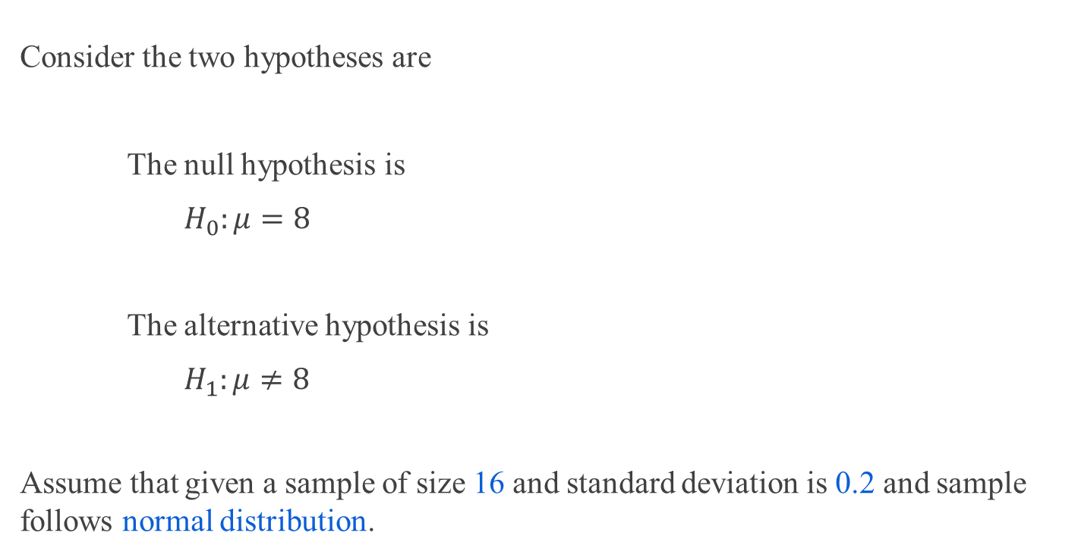
Example 6.7: Calculating$α$
Consider the two hypotheses are
The null hypothesis is
$$H_{0}:μ=8$$
The alternative hypothesis is
$$H_{1}:μ≠8$$
Assume that given a sample of size 16 and standard deviation is 0.2 and sample follows normal distribution.

Slide 25
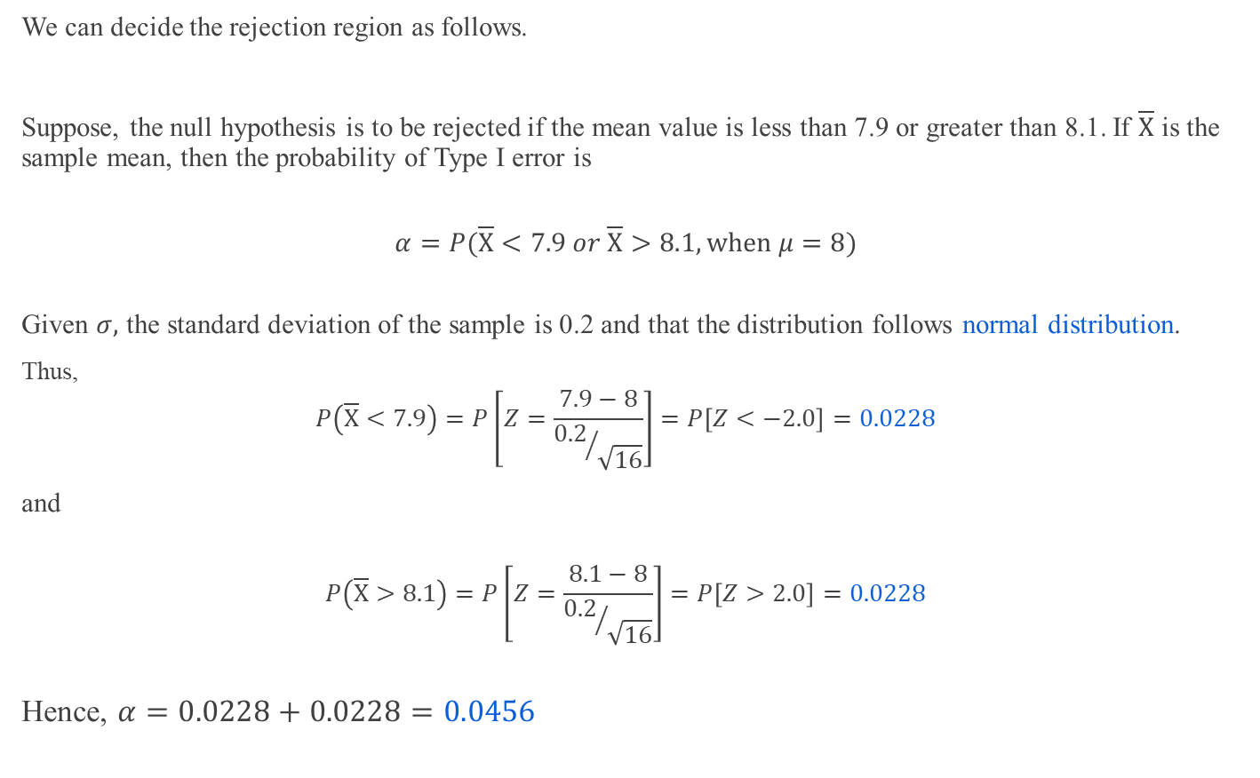
Example 6.7: Calculating$α$
We can decide the rejection region as follows.
Suppose, the null hypothesis is to be rejected if the mean value is less than 7.9 or greater than 8.1. If $\overline{X}$ is the sample mean, then the probability of Type I error is
$$α=P(\overline{X}<7.9 or \overline{X}>8.1, when μ=8)$$
Given $σ,$ the standard deviation of the sample is 0.2 and that the distribution follows normal distribution.
Thus,
$$P\left(\overline{X}<7.9\right)=P\left[Z=\frac{7.9−8}{{0.2}/{\sqrt{16}}}\right]=P\left[Z<−2.0\right]=0.0228$$
and
$$P\left(\overline{X}>8.1\right)=P\left[Z=\frac{8.1−8}{{0.2}/{\sqrt{16}}}\right]=P\left[Z>2.0\right]=0.0228$$
Hence, $α=0.0228+0.0228=0.0456$

Slide 26

Example 6.8: Calculating$α$and$β$
There are two identically appearing boxes of chocolates. Box A contains 60 red and 40 black chocolates whereas box B contains 40 red and 60 black chocolates. There is no label on the either box. One box is placed on the table. We are to test the hypothesis that “Box B is on the table”.
To test the hypothesis an experiment is planned, which is as follows:
Draw at random five chocolates from the box.
We replace each chocolates before selecting a new one.
The number of red chocolates in an experiment is considered as the sample statistics.
Note: Since each draw is independent to each other, we can assume the sample distribution
follows binomial probability distribution.

Slide 27


Example 6.8: Calculating$α$
Let us express the population parameter as $p=the number of red chocolates in Box B.$
The hypotheses of the problem can be stated as:
$H_{0}:p=0.4$ // Box B is on the table
${ H}_{1}:p=0.6$ // Box A is on the table
Calculating $α:$
In this example, the null hypothesis ${(H}_{0})$ specifies that the probability of drawing a red chocolate is $0.4$. This means that, lower proportion of red chocolates in observations $(i.e., sample)$ favors the null hypothesis. In other words, drawing all red chocolates provides sufficient evidence to reject the null hypothesis. Then, the probability of making a $Type I$ error is the probability of getting five red chocolates in a sample of five from Box B. That is,
$$α=P\left(X=5 when p=0.4\right)$$
Using the binomial distribution
$$=\frac{n!}{x!\left(n−x\right)!}p^{x}{(1−p)}^{n−x}where n=5, x=5$$
$$={(0.4)}^{5}=0.01024$$
Thus, the probability of rejecting a true null hypothesis is $≈0.01.$ That is, there is approximately $1 in 100$chance that the box B will be mislabeled as box A.

Slide 28

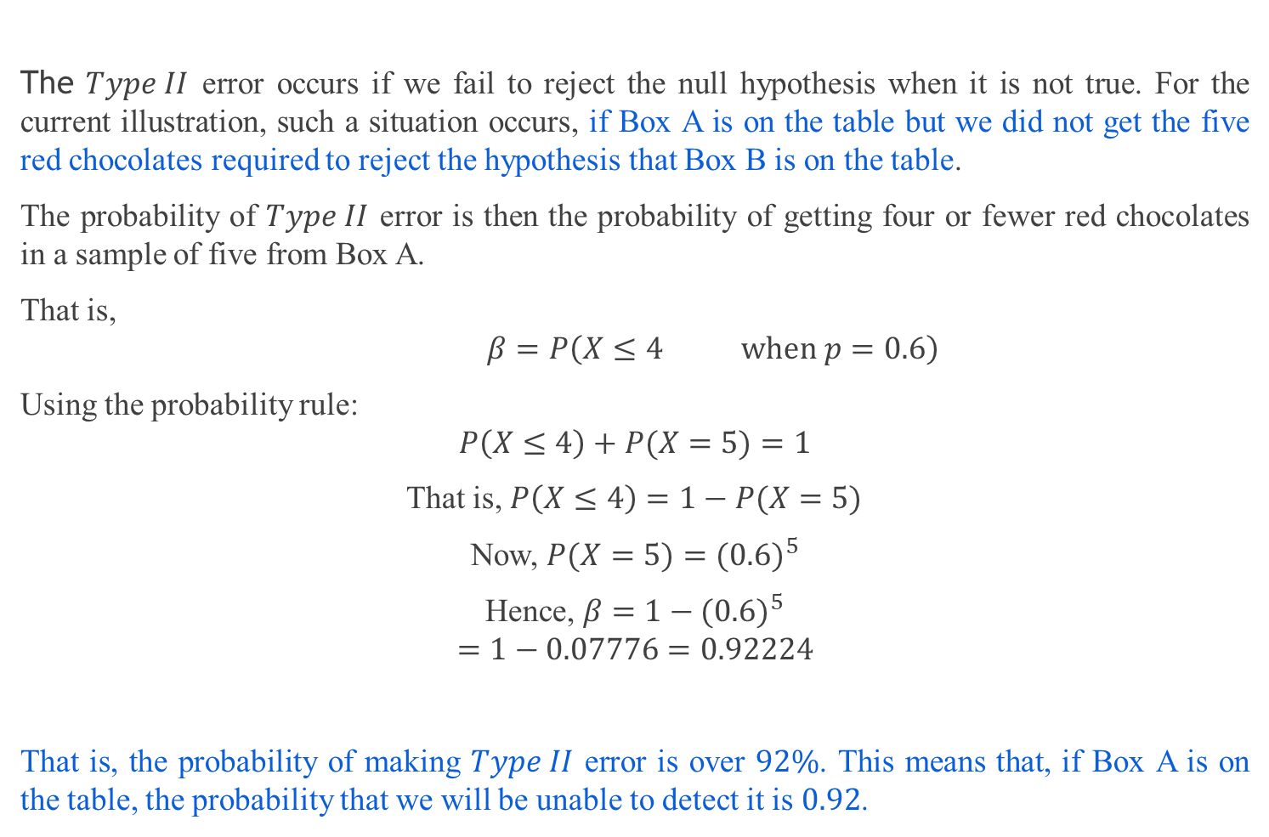
Example 6.8: Calculating$β$
The $Type II$ error occurs if we fail to reject the null hypothesis when it is not true. For the current illustration, such a situation occurs, if Box A is on the table but we did not get the five red chocolates required to reject the hypothesis that Box B is on the table.
The probability of $Type II$ error is then the probability of getting four or fewer red chocolates in a sample of five from Box A.
That is,
$$β=P\left(X≤4 when p=0.6\right)$$
Using the probability rule:
$$P\left(X≤4\right)+P(X=5)=1$$
That is, $P\left(X≤4\right)=1−P(X=5)$
Now, $P(X=5)={(0.6)}^{5}$
Hence, $β=1−{(0.6)}^{5}$
$$=1−0.07776=0.92224$$
That is, the probability of making $Type II$ error is over $92\%$. This means that, if Box A is on the table, the probability that we will be unable to detect it is $0.92$.

Slide 29

Case Study 1: Coffee Sale
A coffee vendor nearby Kharagpur railway station has been having average sales of 500 cups per day. Because of the development of a bus stand nearby, it expects to increase its sales. During the first 12 days, after the inauguration of the bus stand, the daily sales were as under:
550 570 490 615 505 580 570 460 600 580 530 526
On the basis of this sample information, can we conclude that the sales of coffee have increased?
Consider 5% level of confidence.

Slide 30

Hypothesis Testing : 5 Steps
The following five steps are followed when testing hypothesis
Specify $H_{0}$ and $H_{1}$, the null and alternate hypothesis, and an acceptable level of $α$.
Determine an appropriate sample-based test statistics and the rejection region for the specified $H_{0}$.
Collect the sample data and calculate the test statistics.
Make a decision to either reject or fail to reject $H_{0}$.
Interpret the result in common language suitable for practitioner.

Slide 31
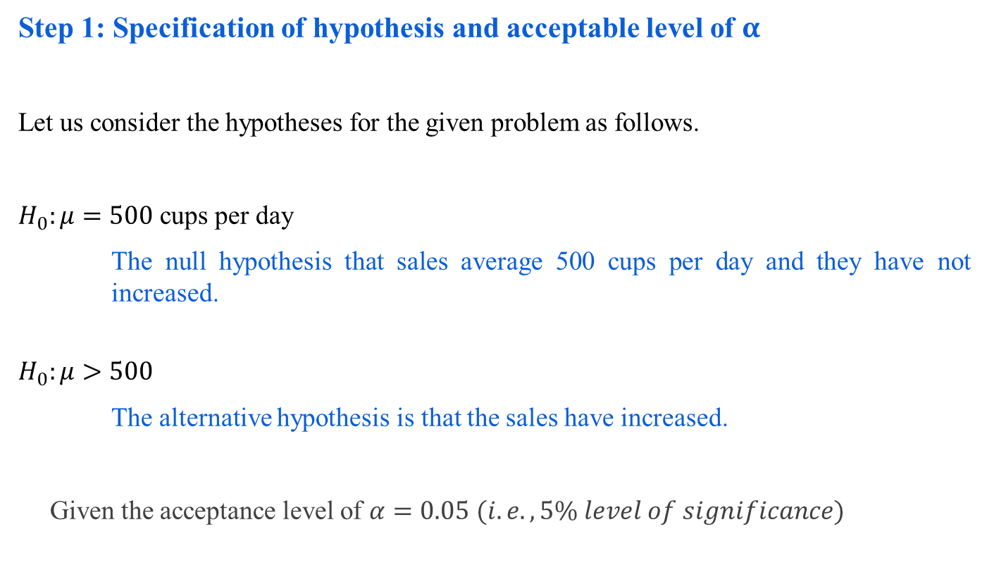
Case Study 1: Step 1
Step 1: Specification of hypothesis and acceptable level of $α$
Let us consider the hypotheses for the given problem as follows.
$H_{0}:μ=500$ cups per day
The null hypothesis that sales average 500 cups per day and they have not increased.
$$H_{0}:μ>500$$
The alternative hypothesis is that the sales have increased.
Given the acceptance level of $α=0.05(i.e., 5\% level of significance)$

Slide 32
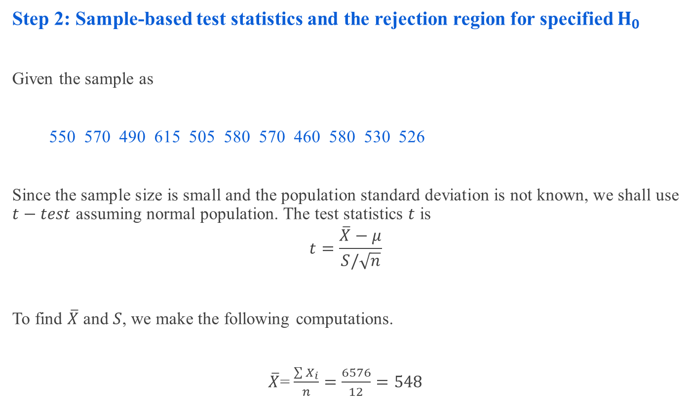
Case Study 1: Step 2
Step 2: Sample-based test statistics and the rejection region for specified $H_{0}$
Given the sample as
550 570 490 615 505 580 570 460 580 530 526
Since the sample size is small and the population standard deviation is not known, we shall use $t−test$ assuming normal population. The test statistics $t$ is
$$t=\frac{\overline{X}−μ}{S/\sqrt{n}}$$
To find $\overline{X}$ and $S$, we make the following computations.
$\overline{X}$=$\frac{\sum{X_{i}}}{n}=\frac{6576}{12}=548$

Slide 33
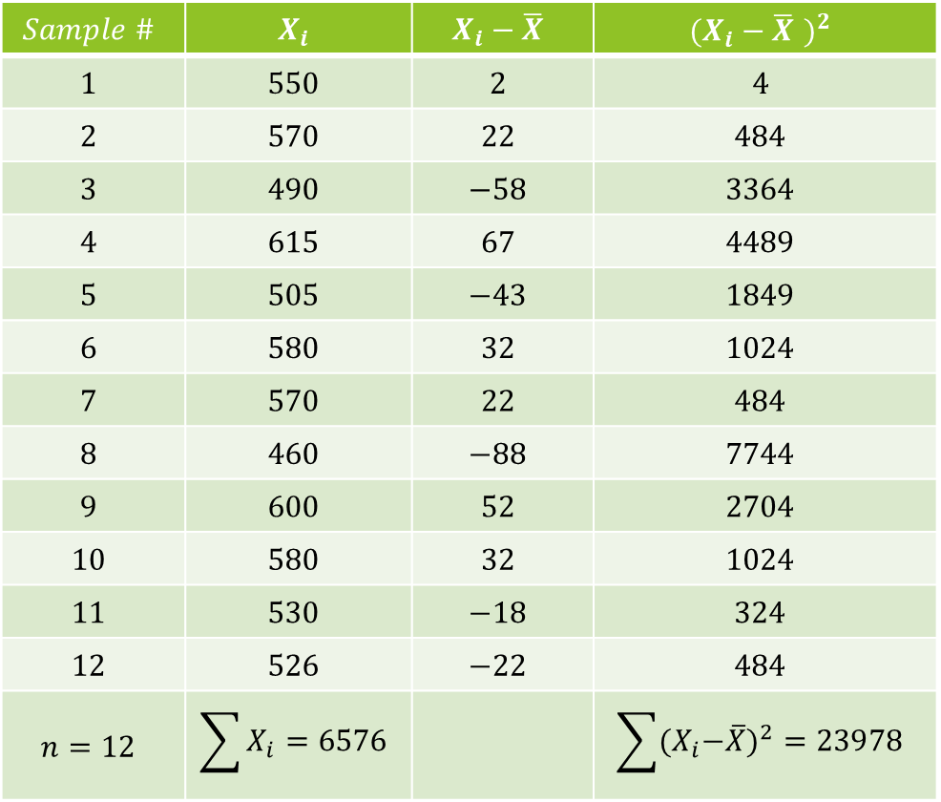
Case Study 1: Step 2
$$Sample \#$$ | $$X_{i}$$ | $$X_{i}−\overline{X}$$ | $${(X_{i}−\overline{X} )}^{2}$$
$$1$$ | $$550$$ | $$2$$ | $$4$$
$$2$$ | $$570$$ | $$22$$ | $$484$$
$$3$$ | $$490$$ | $$−58$$ | $$3364$$
$$4$$ | $$615$$ | $$67$$ | $$4489$$
$$5$$ | $$505$$ | $$−43$$ | $$1849$$
$$6$$ | $$580$$ | $$32$$ | $$1024$$
$$7$$ | $$570$$ | $$22$$ | $$484$$
$$8$$ | $$460$$ | $$−88$$ | $$7744$$
$$9$$ | $$600$$ | $$52$$ | $$2704$$
$$10$$ | $$580$$ | $$32$$ | $$1024$$
$$11$$ | $$530$$ | $$−18$$ | $$324$$
$$12$$ | $$526$$ | $$−22$$ | $$484$$
$$n=12$$ | $$\sum{X_{i}=6576}$$ |  | $$\sum{{{(X}_{i}−\overline{X})}^{2}=23978}$$

Slide 34

Case Study 1: Step 2
$$S=\sqrt{\frac{{\sum{(X_{i}−\overline{X})}}^{2}}{n−1}}=\sqrt{\frac{23978}{12−1}}=46.68$$
Hence, $t=\frac{\overline{X}−μ }{S/\sqrt{n}}=\frac{48}{46.68/\sqrt{12}}=\frac{48}{13.49}=3.558$
Note:
Statistical table for t-distributions gives a t-value given n, the degrees of freedom and $α$, the level of significance and vice-versa.

Slide 35

Case Study 1: Step 3
Step 3: Collect the sample data and calculate the test statistics
$$Degree of freedom=n−1=12−1=11$$
As $H_{1}$ is one-tailed, we shall determine the rejection region applying one-tailed in the right tail because $H_{1}$ is more than type ) at $5\%$ level of significance.

Slide 36

Case Study 1: Step 3
Step 3: Collect the sample data and calculate the test statistics
$$Degree of freedom=n−1=12−1=11$$
As $H_{1}$ is one-tailed, we shall determine the rejection region applying one-tailed in the right tail because $H_{1}$ is more than type ) at $5\%$ level of significance.
Using table of $t−distribution$ for 11 degrees of freedom and with $5\%$ level of significance,
$$R:t>1.796$$

Slide 37

Case Study 1: Step 4
Step 4: Make a decision to either reject or fail to reject H₀
The observed value of $t=3.558$ which is in the rejection region and thus $H_{0}$ is rejected at $5\%$ level of significance.

Slide 38
Case Study 1: Step 5
Step 5: Final comment and interpret the result
We can conclude that the sample data indicate that coffee sales have increased.

Slide 39
Hypothesis Testing Strategies
The hypothesis testing determines the validity of an assumption (technically described as null hypothesis), with a view to choose between two conflicting hypothesis about the value of a population parameter.
There are two types of tests of hypotheses
Non-parametric tests (also called distribution-free test of hypotheses)
Parametric tests (also called standard test of hypotheses).

Slide 40
Parametric Tests : Applications
Usually assume certain properties of the population from which we draw samples.
Observation come from a normal population
Sample size is small
Population parameters like mean, variance, etc. are hold good.
Requires measurement equivalent to interval scaled data.

Slide 41

Parametric Tests
Important Parametric Tests
The widely used sampling distribution for parametric tests are
$Z−test$
$t−test$
$χ^{2}−test$
$F−test$
Note:
All these tests are based on the assumption of normality (i.e., the source of data is considered to be normally distributed).

Slide 42
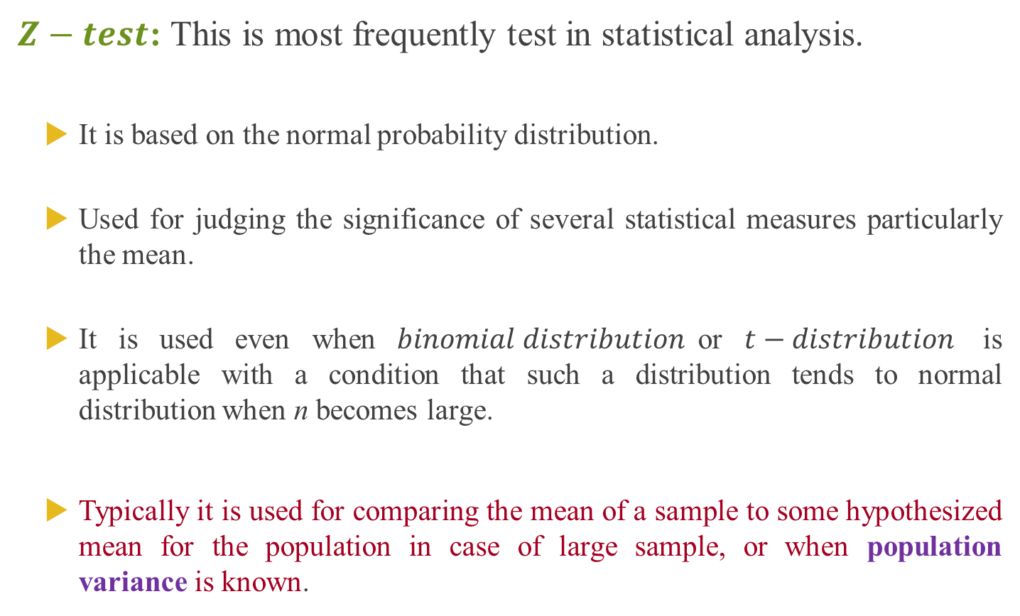
Parametric Tests : Z-test
$Z−test$:This is most frequently test in statistical analysis.
It is based on the normal probability distribution.
Used for judging the significance of several statistical measures particularly the mean.
It is used even when $binomial distribution$or $t−distribution$ is applicable with a condition that such a distribution tends to normal distribution when n becomes large.
Typically it is used for comparing the mean of a sample to some hypothesized mean for the population in case of large sample, or when population variance is known.

Slide 43

Parametric Tests : t-test
$t−test$: It is based on the t-distribution.
It is considered an appropriate test for judging the significance of a sample mean or for judging the significance of difference between the means of two samples in case of
small sample(s)
population variance is not known (in this case, we use the variance of the sample as an estimate of the population variance)

Slide 44


Parametric Tests : $χ^{2}$-test
$χ^{2}−test$: It is based on Chi-squared distribution.
It is used for comparing a sample variance to a theoretical population variance.

Slide 45


Parametric Tests : $F$-test
$F−test$: It is based on F-distribution.
It is used to compare the variance of two independent samples.
This test is also used in the context of analysis of variance (ANOVA) for judging the significance of more than two sample means.

Slide 46

Hypothesis Testing : Assumptions
Case 1:Normal population, population infinite, sample size may be large or small, variance of the population is known.
$$z=\frac{\overline{X}−μ_{H_{0}}}{σ/\sqrt{n}}$$
Case 2: Population normal, population finite, sample size may large or small………variance is known.
$$z=\frac{\overline{X}−μ_{H_{0}}}{σ/\sqrt{n}[\sqrt{(N−n)/(N−1)}]}$$
Case 3: Population normal, population infinite, sample size is small and variance of the population is unknown.
$$t=\frac{\overline{X}−μ_{H_{0}}}{S/\sqrt{n}} with degree of freedom=(n−1)$$
and$s=\sqrt{\frac{\sum{{(X_{i}−\overline{X})}^{2}}}{(n−1)}}$

Slide 47

Hypothesis Testing
Case 4:Population finite
$$t=\frac{\overline{X}−μ_{H_{0}}}{σ/\sqrt{n}[\sqrt{(N−n)/(N−1)}]}with degree of freedom=(n−1)$$
Note: If variance of population $\left(σ\right)$ is known, replace $S$ by $σ$. Population normal, population infinite, sample size is small and variance of the population is unknown.

Slide 48
Hypothesis Testing : Non-Parametric Test
Non-Parametric tests
Does not under any assumption
Assumes only nominal or ordinal data
Note: Non-parametric tests need entire population (or very large sample size)

Slide 49
More about the P-Value
The P-value is a probability that describes the likelihood of the data if the null hypothesis is true.
More specifically, the P-value is the probability that sample results are as extreme as or more extreme than the data if the null hypothesis is true.
The phrase “as extreme as or more extreme than” means farther from the center of the sampling distribution in the direction of the alternative hypothesis.
More generally, we view the P-value a description of the strength of the evidence against the null hypothesis and in support of the alternative hypothesis.
But the P-value is a probability about sample results, not about the null or alternative hypothesis.

Slide 50
One More Note about P-Values and the Significance Level
You may wonder why 5% is often selected as the significance level in hypothesis testing and why 1% is also a commonly used level. It is largely due to just convenience and tradition.
When Ronald Fisher (one of the founders of modern statistics) published one of his tables, he used a mathematically convenient scale that included 5% and 1%. Later, these same 5% and 1% levels were used by other people, in part just because Fisher was so highly esteemed. But mostly, these are arbitrary levels.
The idea of selecting some sort of relatively small cutoff was historically important in the development of statistics. But it’s important to remember that there is really a continuous range of increasing confidence toward the alternative hypothesis, not a single all-or-nothing value.
There isn’t much meaningful difference, for instance, between the P-values 0.049 and 0.051, and it would be foolish to declare one case definitely a “real” effect and the other case definitely a “random” effect. In either case, the study results are roughly 5% likely by chance if there’s no actual effect.
Whether such a P-value is sufficient for us to reject a particular null hypothesis ultimately depends on the risk of making the wrong decision and the extent to which the hypothesized effect might contradict our prior experience or previous studies.

Slide 51
EXAMPLE
Sample Size and Hypothesis Testing
Consider our earlier example about teenagers and Internet access. According to the Kaiser Family Foundation, 84% of U.S. children ages 8 to 18 had Internet access at home as of August 2009. Researchers wonder if this number has changed since then. The hypotheses we tested were:
H₀: p = 0.84
H_{a}: p ≠ 0.84
The original sample consisted of 500 children, and 86% of them had Internet access at home. The P-value was about 0.22, which was not strong enough to reject the null hypothesis. There was not enough evidence to show that the proportion of all U.S. children ages 8 to 18 have Internet access at home.
Suppose we sampled 2,000 children and the sample proportion was still 86%. Our test statistic would be Z ≈ 2.44, and our P-value would be about 0.015. The larger sample size would allow us to reject the null hypothesis even though the sample proportion was the same.

Slide 52
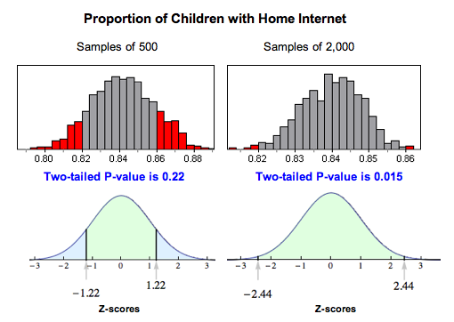
Why does this happen? Larger samples vary less, so a sample proportion of 0.86 is more unusual with larger samples than with smaller samples if the population proportion is really 0.84.
This means that if the alternative hypothesis is true, a larger sample size will make it more likely that we reject the null. Therefore, we generally prefer a larger sample as we have seen previously.

Slide 53
Drawing Conclusions from Hypothesis Tests
It is tempting to get involved in the details of a hypothesis test without thinking about how the data was collected.
Whether we are calculating a confidence interval or performing a hypothesis test, the results are meaningless without a properly designed study.
Consider the following exercises about how data collection can affect the results of a study.
TRY The below
Data from the Center for Disease Control estimates that about 30.4% of American teenagers were overweight in 2008. The definition of overweight is a body mass index (BMI) of over 25. The percentage was very similar for boys and girls.
A professor in public health at a major university wants to determine whether the proportion has changed since 2008. He samples 800 randomly selected incoming freshman at universities around the country. Using the BMI measurements, he finds that 210, or about 26%, of them are overweight.
The professor tests the hypotheses H₀ : p = 0.304 versus H_{a} : p ≠ 0.304. The P-value is about 0.011. If the professor uses a significance level of 0.05, what conclusion can he draw?

Slide 54
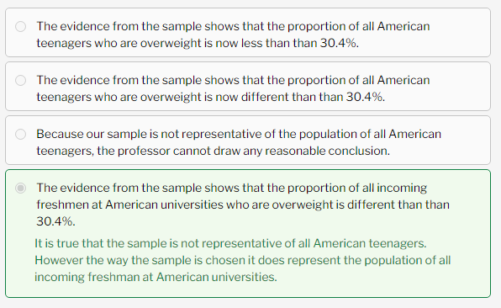

Slide 55

Let’s Summarize
In this section, we looked at the four steps of a hypothesis test as they relate to a claim about a population proportion.
Step 1: Determine the hypotheses.
The hypotheses are claims about the population proportion, p.
The null hypothesis is a hypothesis that the proportion equals a specific value, p₀.
The alternative hypothesis is the competing claim that the parameter is less than, greater than, or not equal to p₀.
Step 2: Collect the data.
Since the hypothesis test is based on probability, random selection or assignment is essential in data production. Additionally, we need to check whether the sample proportion can be np ≥ 10 and n(1 − p) ≥ 10.
Step 3: Assess the evidence.
Determine the test statistic which is the z-score for the sample proportion. The formula is:
Use the test statistic, together with the alternative hypothesis to determine the P-value. You can use a standard normal table (or Z-table) or technology (such as the simulations on the second page of this topic) to find the P-value.
If the alternative hypothesis is greater than, the P-value is the area to the right of the test statistic. If the alternative hypothesis is less than, the P-value is the area to the left of the test statistic. If the alternative hypothesis is not equal to, the P-value is equal to double the tail area beyond the test statistic.

Slide 56
Step 4: Give the conclusion.
A small P-value says the data is unlikely to occur if the null is true. If the P-value is less than or equal to the significance level, we reject the null hypothesis and accept the alternative hypothesis instead.
If the P-value is greater than the significance level, we say we “fail to reject” the null hypothesis. We never say that we “accept” the null hypothesis.
We just say that we don’t have enough evidence to reject it. This is equivalent to saying we don’t have enough evidence to support the alternative hypothesis.
We write the conclusion in the context of the research question. Our conclusion is usually a statement about the alternative hypothesis (we accept H_{a} or fail to accept H_{a}) and should include the P-value.

Slide 57
Remember that the P-value is the probability of seeing a sample proportion as extreme as the one observed from the data if the null hypothesis is true. The probability is about the random sample, not about the null or alternative hypothesis.
A larger sample size makes it more likely that we will reject the null hypothesis if the alternative is true. Another way of thinking about this is that increasing the sample size will decrease the likelihood of a type II error. Recall that a type II error is failing to reject the null hypothesis when the alternative is true.
Increasing the sample size can have the unintended effect of making the test sensitive to differences so small they don’t matter. A statistically significant difference is one large enough that it is unlikely to be due to sampling variability alone. Even a difference so small that it is not important can be statistically significant if the sample size is big enough.
Finally, remember the phrase “garbage in, garbage out.” If the data collection methods are poor, then the results of a hypothesis test are meaningless. No statistical methods can create useful information if our data comes from convenience or voluntary response samples. Additionally, the results of a hypothesis test apply only to the population from whom the sample was chosen.

Slide 58
What are P-Values?
P-values evaluate how well the sample data supports that the null hypothesis is true. It measures how correct your sample data are with the null hypothesis.
While performing Statistical tests, a threshold value or the alpha needs to be set prior to starting the test. A common value for it is 0.05, which can be thought of as a probability. P-values are defined as the probability of getting the outcome as rare as that alpha or even rarer.
Therefore, if we get our P-value less than that alpha, that would mean that our statistical test didn’t occur by chance and it was indeed significant. So, if our P-Value comes, say, 0.04, we say we reject the Null Hypothesis.
A low P value suggests that your sample provides enough evidence that you can reject the null hypothesis for the entire population. If you got a P-Value of anything less than 0.05 in our case, then you can safely say that the null hypothesis can be rejected. In other words, the sample you took from the population didn’t occur by pure chance and the experiment indeed had a significant effect.
So what can go wrong?
As we say that getting any P-value of less than alpha gives us the liberty to safely reject the Null Hypothesis, we might be making a mistake if our experiment itself is not showing the right picture! In other words, it might be a false positive.

Slide 59
What is P-Hacking?
We say that we P-Hacked when we incorrectly exploit the statistical analysis and falsely conclude that we can reject the null hypothesis. Let’s understand this in detail.
# Hack 1
Consider we have 5 types of CoronaVirus candidate Vaccines with us for which we need to check which one has actual impact on recovery time of patients. So let’s say we do Hypothesis Tests for all 5 types of vaccines one by one. We set the alpha as 0.05. And hence if P-Value for any vaccine comes less than that, we say we can reject the Null Hypothesis.. Or can we?
Example 1
Say, Vaccine A gives a P-Value of 0.2, Vaccine B gives 0.058, Vaccine C gives 0.4, Vaccine D gives 0.02, Vaccine E gives 0.07. Now, by above results, a naive way to deduce will be that Vaccine D is the one which significantly reduces recovery time and can be used as the CoronaVirus Vaccine. But can we really say that just yet? No. If we do, we might be P-Hacking. As this can be a false positive.
Example 2
Okay, let’s take it another way. Consider we have a Vaccine X and we surely know that this Vaccine is useless and has no effect on recovery time. Still we carry out 10 hypothesis tests by different random samples each time with P-Value of 0.05. Say we get the following P-values in our 10 tests: 0.8, 0.7, 0.78, 0.65, 0.03, 0.1, 0.4, 0.09, 0.6, 0.75.
Now if we had to consider the above tests, the test with a surprisingly low P-Value of 0.03 would have made us reject the Null Hypothesis, but in reality it was not. So what do we see from the above examples? In essence, when we say that alpha = 0.05 we set a confidence interval of 95%. And that means that 5% of the tests will still result in errors as above.

Slide 60
Multiple Testing Problem
One way to tackle this would be to increase the number of tests. So more the tests, more easily you can say that the maximum number of tests are resulting in rejection of Null. But also, more tests will mean that there will be more false positives(5% of total tests in our case). 5 out of 100, 50 out of 1000 or 500 out of 10,000! This is also called the Multiple Testing Problem.
False Discovery Rate
One of the ways to tackle above problems is to adjust all the P-Value by using a mechanism called False Discovery Rate (FDR). FDR is a mathematical adjustment of the P-Values which increases them by some values and in the end, the P-Values which incorrectly came lower, might get adjusted to values higher than 0.05.

Slide 61
# Hack 2
Now consider a case from example where Vaccine B gave a P-value of 0.058. Wouldn’t you be tempting to add some more data and retest to see if P-Value decreases? Say, you add a few more data points, and the P-value for Vaccine B came to be 0.048. Is this legit? No, you’d again be P-Hacking. We cannot change or add data to suit our tests later and the exact sample size needs to be decided prior to performing the tests by doing Power Analysis.
Power Analysis tells us the right sample size we need to have the maximum chances of correctly rejecting the null hypothesis and not getting fooled.
# Hack 3
One more mistake you shouldn’t do is to change the alpha after you perform the experiments. So once you see a P-Value of 0.058, you think what if my alpha was 0.06?
But you cannot change it once your experiment starts.

